Slide 1
Learner language and language learning Ch. 18
Claus Færch, Kirsten Hastrup, Robert Phillipson
Some methods of analysis

Slide 2
Glossary
IL = Interlanguage
L1 = Native language
L2 = Secondary language
Orthographic = the conventional spellings of a language; Greek roots ortho, meaning correct, and graphos, meaning writing.
Syntactic = the rules of constructing writing eg. sentences etc.
Lexical = vocabulary, words, or morphemes of a language
Morphological = The study of words and how they are formed. E.g roots, affixes and suffixes

Slide 3
What is this text?
Insight into IL studies
Examples of performance analysis
Examples of Error correction

Slide 4
What is this text NOT
A detailed guide on how to correct students essays
A realistic way of working with scientifically correct error classification

Slide 5
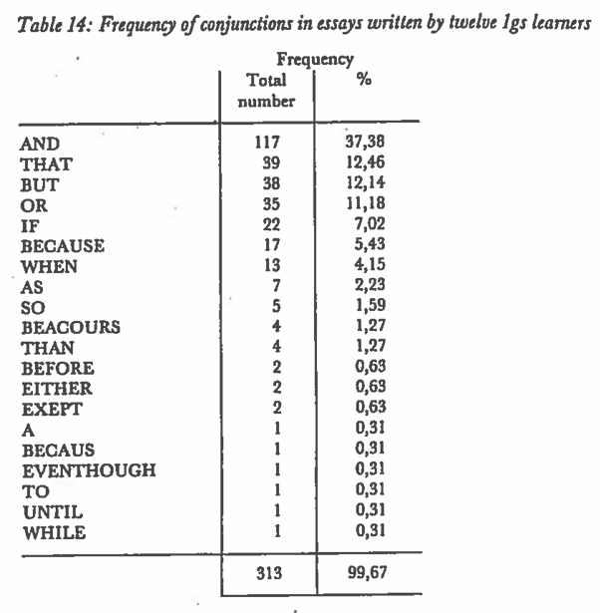
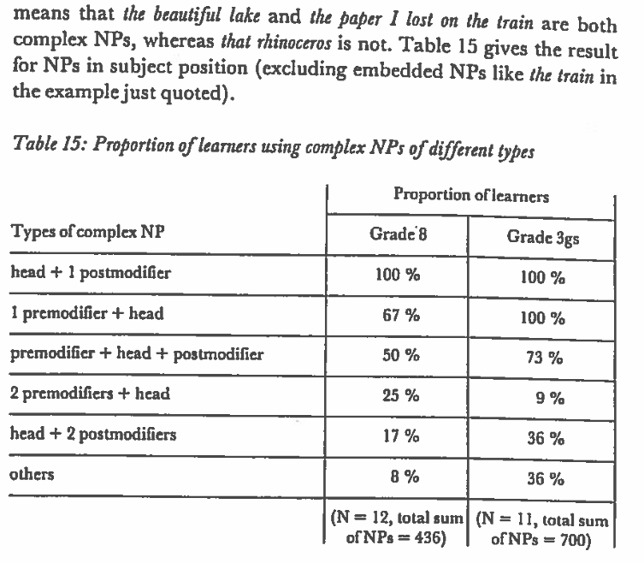
Performance analysis
Frequency of conjunctions
Complexity

Slide 6
Error analysis
Identification
Classification into linguistic categories
Classification according to the causes of the errors

Slide 7
Identification
Use the norms of the target language
Even native speakers of a language may not agree

Slide 8
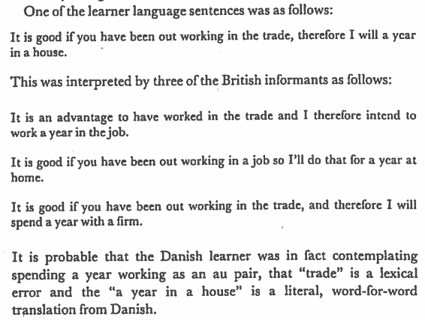
Example (tolerance testing)

Slide 9
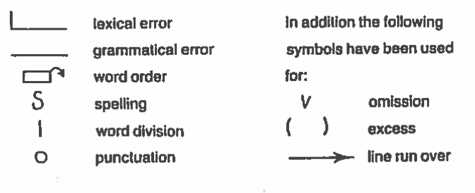
Classification into linguistic categories

Slide 10
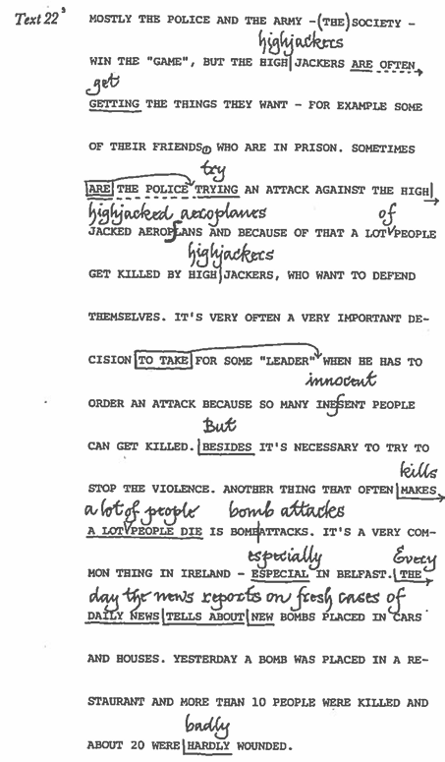
Classification into linguistic categories

Slide 11
Classification into linguistic categories

Slide 12
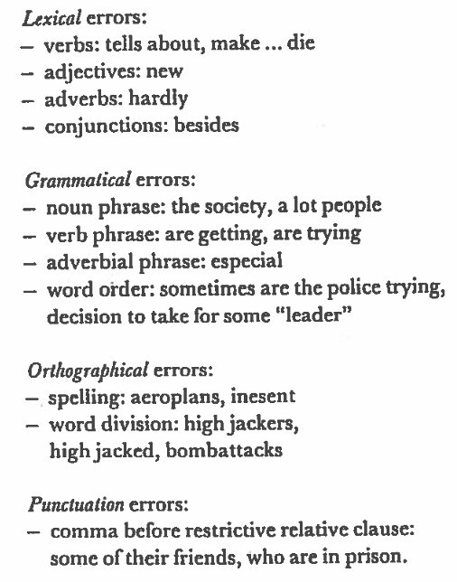
Classification into linguistic categories

Slide 13
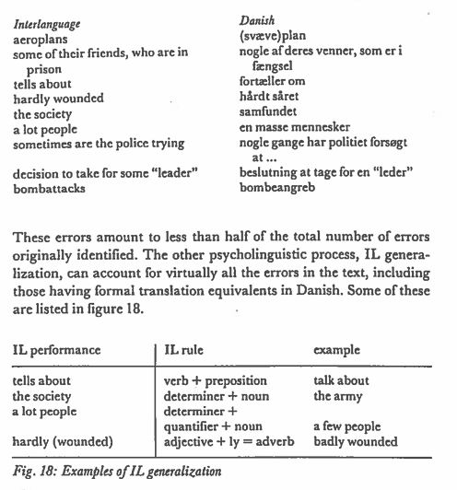
Classification on the basis of Cause

